Slide 1
Writing Skills

Slide 2
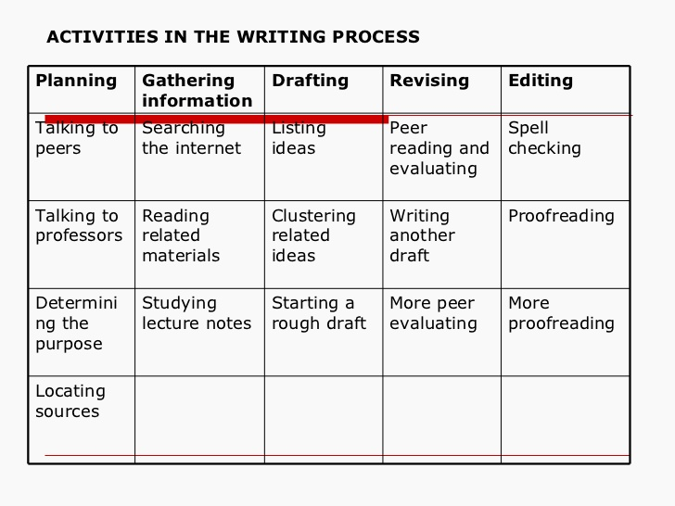

Slide 3
Elements of Written Communication
Technical Elements Elements of form
Words Sentence Length
Sentences Vocabulary-choice of words
Paragraphs Coherence and Transition
Grammar
Punctuation
Structure

Slide 4
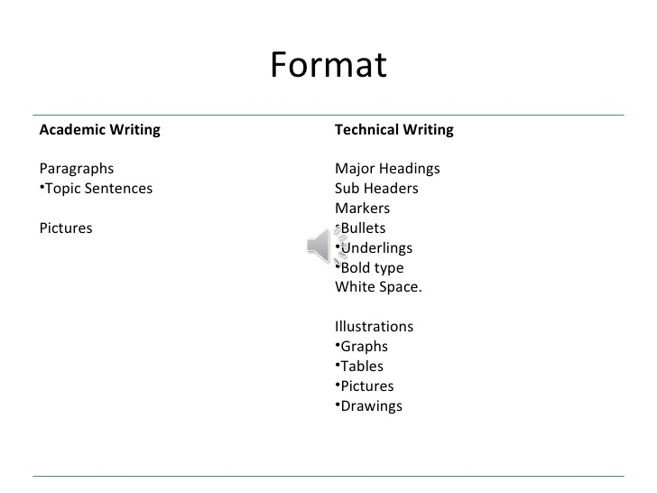

Slide 5
Verbs that establish facts:
concluded, passed, approved, developed discovered, deduced, failed solved.
Verbs that do not establish facts:
May be, perhaps, likely, suggest, suppose…

Slide 6
What is a simple sentence?
It is easy to read
It makes a single point
It is short. The preferred length is 15-20 words.
The message can be read in single reading.
It creates no ambiguity. / ambiguous

Slide 7
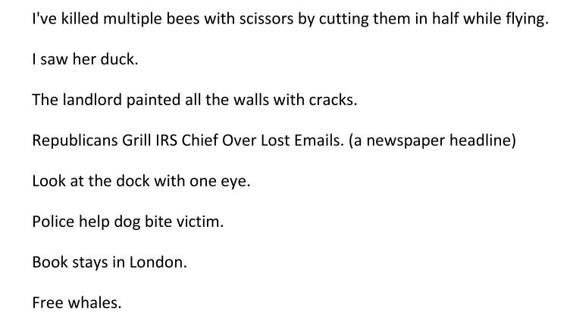

Slide 8
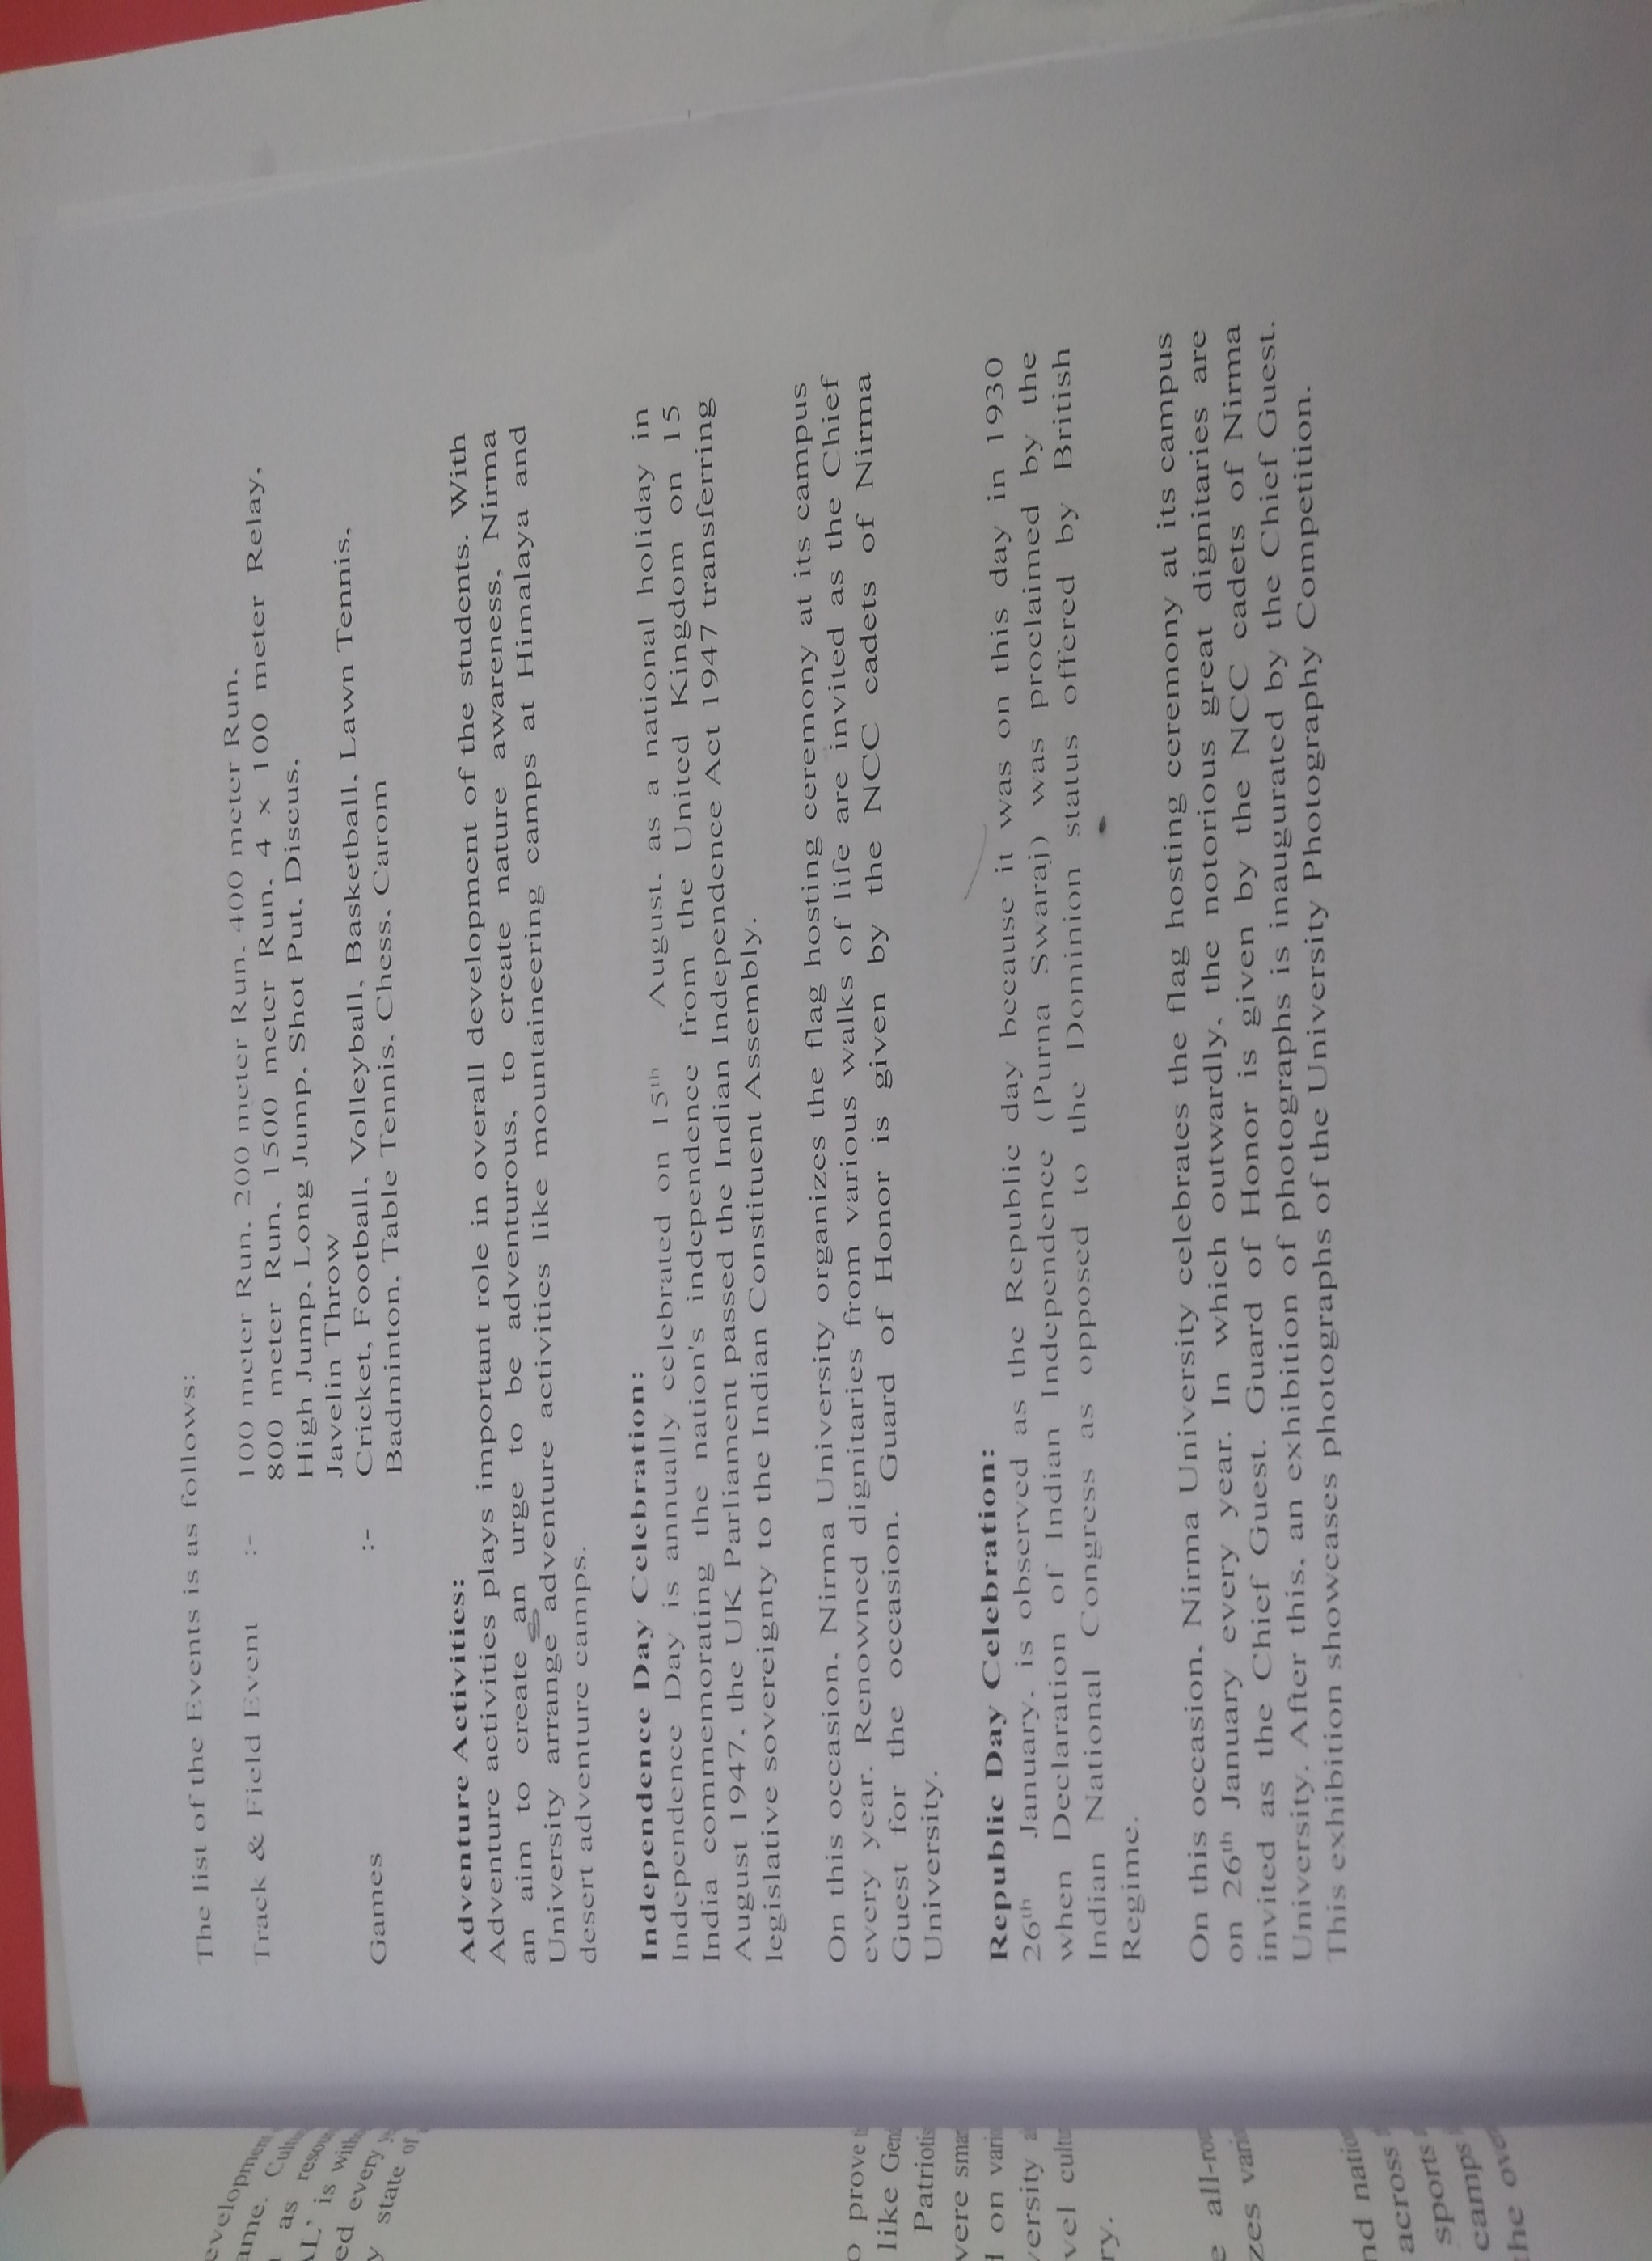

Slide 9
Respected Sir/Madam,
Greetings.
Kindly find enclosed herewith the list of First Review Attendance of off-line students whose Roll Numbers are not visible in the MIS records.
These students pertain to VII Sem. B.Tech.
Kindly do the needful to reach the same to concerned faculty advisors of concerned Department without any delay i.e. TODAY itself.
Thanking you,

Slide 10
Writing shorter sentences techniques-
Spilt and disconnect
I understand that some doctors making night calls have been attacked in recent months on the expectation that they were carrying drugs and their caution when visiting certain areas in the south of the city has been very exacting and has even included telephoning the address to be visited from their car when they arrive outside the house.
B. I understand that some doctors making night calls have been attacked in recent months on the expectation that they were carrying drugs. Their caution when visiting certain areas in the south of the city has been very exacting. It has even included telephoning the address to be visited from their car when they arrive outside the house.

Slide 11
Writing shorter sentences techniques-
Spilt and connect
Winston Churchill was a great politician and statesman. He also won the Nobel Prize for literature.
This is my sister. Her name is Mira.
Say less
Use a list
Cut verbiage:
Advance warning, free sale, Actual fact, Major breakthrough, past history, plan ahead.
Bin the sentence and start again

Slide 12
Writing shorter sentences techniques-
1.Reduce
Smith College, which was founded in 1871, is the premier all-women's college in the United States.
Founded in 1871, Smith College is the premier all-women's college in the United States.
Citizens who knew what was going on voted him out of office.
Knowledgeable citizens voted him out of office.
Recommending that a student copy from another student's paper is not something he would recommend.
He wouldn't recommend that a student copy from another student's paper. (Or "He would never tell a student to copy . . . .")

Slide 13
Components of writing
Developing- through stories, anecdotes examples etc.
Grammar-In a survey (Gerson) of over 700 technical writers (coast to coast) asked to list important aspects of correspondence, 98% ranked correct grammar as an essential component of successful writing.
Organization- Since paragraphs are shorter in technical writing (often between one to three sentences) than in many essays, topic sentences are less important. Transitional words and phrases in an essay can be replaced by an enumerated list, by a list of bullets (!#$%, etc.), and/or by headings and subheadings.

Slide 14
Style
Technical writing, in contrast, demands short, denotative words; short, simple sentences; short, paragraphs with information clarified through graphics (pie charts, line graphs, etc.). It has everything to do with audience and purpose.
Document Design
Document design refers to the physical layout of the correspondence.
Essays consist of words, words, and more words, separated by
indentations to create paragraphs. Technical writing, in contrast, uses
highlighting techniques and graphics for visual appeal to help the reader
access and understand the data.

Slide 15
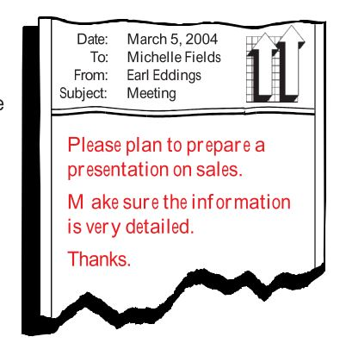
Technical Writing Traits
Clarity

Slide 16
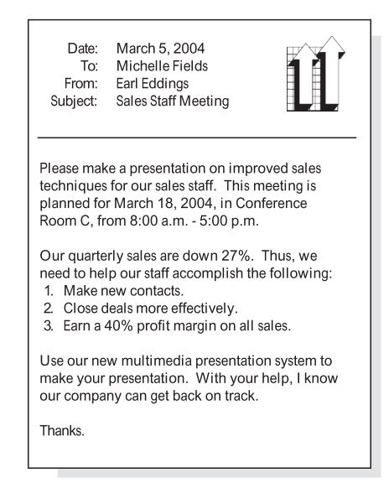

Slide 17
Conciseness
A sentence should contain no unnecessary words, a paragraph no unnecessary sentences, for the same reason that a drawing should have no unnecessary lines and a machine no unnecessary parts.
William Strunk.jr.

Slide 19
Software engineers generally try to minimize the number of lines of code in an implementation for the following reasons:
Shorter code is typically easier for others to read.
Shorter code is typically easier to maintain than longer code.
Extra lines of code introduce additional points of failure.
In fact, the same rules apply to technical writing:
Shorter documentation reads faster than longer documentation.
Shorter documentation is typically easier to maintain than longer documentation.
Extra lines of documentation introduce additional points of failure.
Finding the shortest documentation implementation takes time but is ultimately worthwhile. Short sentences communicate more powerfully than long sentences, and short sentences are usually easier to understand than long sentences.

Slide 20
There is, There are, and There were as sentence openers.
Don't overwork modifiers. Really, very, quite, extremely
Avoid redundancies
Use active verbs
Don't try to show off.
Cut empty phrases.
Avoid using noun forms of verbs
Replace vague nouns with more specific words
https://www.youtube.com/watch?v=4ug8KuOwodk
https://www.youtube.com/watch?v=e_ksOMwnMOg(Very)
https://nybookeditors.com/2016/04/use-these-18-apps-to-improve-your-writing/ ( writing Aps)

Slide 21
all things considered | All things considered, Connecticut's woodlands are in better shape now than ever before. All things considered, Connecticut's woodlands are in better shape now than ever before.
as a matter of fact | As a matter of fact, there are more woodlands in Connecticut now than there were in 1898. as a matter of fact, There are more woodlands in Connecticut now than there were in 1898.
as far as I'm concerned | As far as I'm concerned, there is no need for further protection of woodlands. As far as I'm concerned, there Further protection of woodlands is not needed.

Slide 22
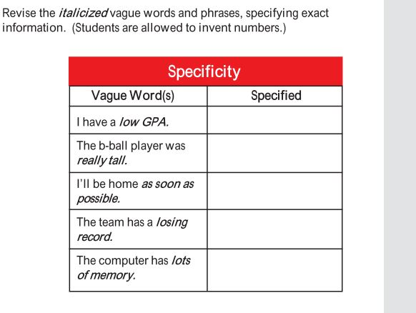

Slide 23
Redundancies
Advance reservation
Add an additional copy
Armed Gunmen
ATM machine
Blend together
Completely filled
Descend down.
We currently have vacant rooms
Get to the point as quickly as possible

Slide 24
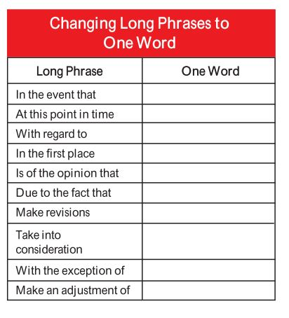

Slide 25
vague: Consumer demand is rising in the area of services.
Precise: Consumers are demanding more services.
Vague: Strong reading skills are an important factor in students' success in college.
Precise: Students' success in college depends on their reading skills
Vague: Photography took on new aspects during the Civil War.
Precise: The Civil War saw the advent of graphic battlefield photography.

Slide 26
Can this be simpler?
Your presence is highly solicited.
This is to inform you that the meeting will be held on July 26,2017.
It will be extremely difficult for us to consider your application of leave
Looking into the azure blue sky we could see the golden or of the sun slip gently beneath the Western sky.

Slide 27
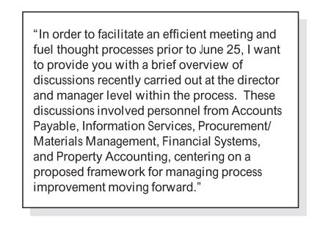

Slide 28
I wish to express indebted gratitude and special thanks to Ms. Ruchi Pawar, my zonal manager. In spite of being extremely busy with her duties she took time out to hear, guide and keep me in the right track. she allowed me to carry out my project at their esteemed institute.

Slide 29
Basically, I'm learning to write. Writing grammatically is totally difficult because of all the tenses, parts of speech, punctuation, etc. I kind of want to learn irregardless. Each and every paper that I write has improved, in terms of grammar. Firstly, I've been working on my sentence structure and also my spelling. Secondly, I've been trying to get rid of awkward phrases that plague my writing. I got a B+ on my last paper! Being as I've worked literally hundreds of hours to improve, this is totally an accomplishment.

Slide 30
Due to the fact that my English teacher stresses the importance of grammar, every student in my class is essentially learning it, whether he/she wants to or not. And he/she had ought to continue to read a lot, since reading is equally as important as writing. As to whether you like my writing, I hope it is considered to be easy to understand. Well, I've got to go to work and/or shopping. Irregardless, I literally must say goodbye!

Slide 31
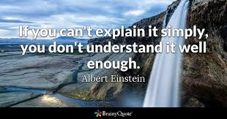

Slide 32
Focus each sentence on a single idea, thought, or concept. Just as statements in a program execute a single task, sentences should execute a single idea.
For example, the following very long sentence contains multiple thoughts:
The late 1950s was a key era for programming languages because IBM introduced Fortran in 1957 and John McCarthy introduced Lisp the following year, which gave programmers both an iterative way of solving problems
and a recursive way.
The late 1950s was a key era for programming languages. IBM introduced Fortran in 1957. John McCarthy invented Lisp the following year. Consequently, by the late 1950s, programmers could solve problems iteratively or recursively.

Slide 33
In bash, use the if, then, and fi statements to implement a simple conditional branching block in which the if statement evaluates an expression, the then statement introduces a block of statements to run when the if expression is true, and the fi statement marks the end of the conditional branching block.

Slide 34
Accessibility
In technical writing, accessibility refers to the ability for users to search, acquire, download, and understand complex communications.
Headings
Headings don’t only visually break up information, they also create metadata that screen readers rely on. Screen readers can recognize and vocalize division in information, that’s why you should pay attention to headings and make it more informative, so screen readers can vocalize it effectively.

Slide 35
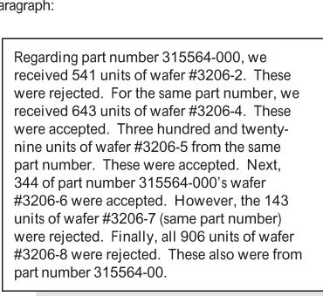

Slide 36
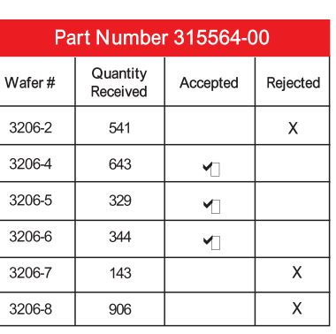

Slide 37
Text Size, Alignment, and Spacing
The first and foremost, text should be clear and concise, so screen readers can also recognize and vocalize it properly. Speaking of formatting, text size, alignment, and spacing make all the difference in readability, that’s why text should not fall below 11pt font to be legible by the naked eye, and it should also be aligned left.
Tables and Images
Despite the fact the tables and images are visual-based, screen readers can vocalize their information that’s why you should pay attention to a few things to make your tables and images more accessible:
Alternate Text. An alternate text is a text that’s put in the properties of the table or image. Screen readers rely on this text, in order to vocalize tables and images. The text should not only describe the look but the content and intent of the table or image.

Slide 38
Colors
When you create charts, visual presentations, graphs, and the like, keep in mind common color combinations affected by colorblindness. For example, blue text with a purple background will be muddied and unreadable to many people who are colorblind.

Slide 39
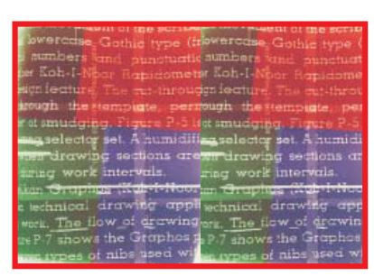

Slide 40
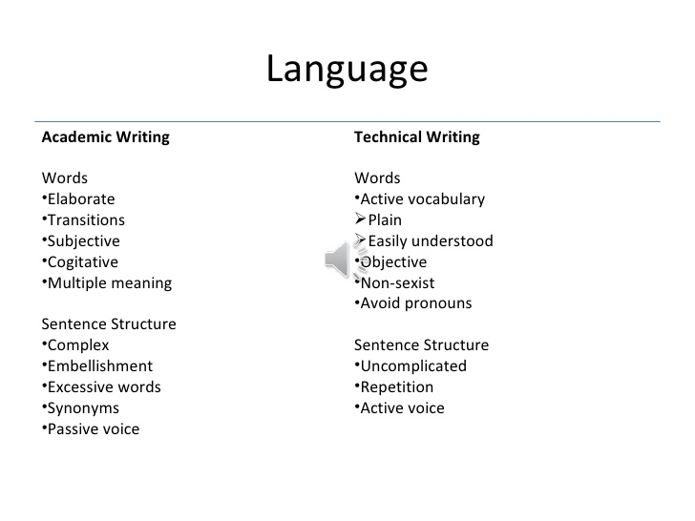

Slide 41
Sexist Language
A police officer should remember that he/she is a public servant and should therefore always be polite.
It is his/her duty to assist the public.
University administrator: Could each candidate please leave his or her exam registration form at the office before midday, please? (spoken)

Slide 42
UNDERSTANDING WRITTEN COMMUNICATION
Single Reader, multiple readers, unintended readers
No opportunity of clarification or seeking feedback
Establishing a context
Closing the message

Slide 43
Every pilot must inspect the outside of his plane before he gets into the cockpit.
Throughout the history of mankind, war has been the main way countries have obtained additional land.
In my opinion, a person cannot be a good doctor if he is not caring, concerned, and competent.
Every student has been tested

Slide 44
Euphemisms
Ethnic Cleansing
Enhanced interrogation
Kicked the bucket
Correction facility
Differently abled
Domestic engineer
Letting some one go
Big-boned
Pre-loved vehicle
On the streets

Slide 45
Conciseness
1.At this point in time we can't ascertain the reason as to why the screen door was left open.
We don't know why the screen door was left open.
2.My sister, who is employed as a nutritionist at the University of Michigan, recommends the daily intake of megadoses of Vitamin C.
My sister, a nutritionist at the University of Michigan, recommends daily megadoses of Vitamin C.
3.It is to be hoped that we discover a means to create an absolutely proper and fitting tribute to Professor Espinoza
We hope for an appropriate tribute to Professor Espinoza.

Slide 46
He dropped out of school on account of the fact that it was necessary for him to help support his family.
It is very unusual to find someone who has never told a deliberate lie on purpose.
A campus rally was attended by more than a thousand students. Five students were arrested by campus police for disorderly conduct, while several others are charged by campus administrators with organizing a public meeting without being issued a permit to do so.
He dropped out of school to support his family.
Rarely will you find someone who has never told a deliberate lie
Five out of more than a thousand students at a campus rally were arrested for disorderly conduct, and several others were charged by campus administrators with organizing a public meeting without a permit.

Slide 47
In the cellar there are four wooden-type crates with nothing in them that might perhaps be used by us for storing paint cans inside of.
This morning at 6:30 a.m., I woke up out of sleep to hear my alarm go off, but the alarm was turned off by me,
and I returned back to a sleeping state.
The reason that Merdine was not able to be in attendance at the hockey game was because she had jury duty. conciseness-2.pdf

Slide 48
FORMAT
Introduction
Procedure
Results
Discussion
Recommendations

